Slide 1
CICS

Slide 2
Session - I

Slide 3
Objectives
Computer Application Systems
Why is CICS Sub-system needed?
History of CICS
What is CICS?
What does CICS do?
CICS System Components
Concepts of CICS
Terminologies in CICS
CICS Nucleus
CICS Commands
Execution of an application program
Lab Session
Notes:
In the day’s session let us discuss the introduction to CICS….its history, why we use CICS, what it does and some of the basic concepts of CICS like the components of CICS, certain core concepts, the terminologies used and so on . We’ll also discuss how to execute an application program towards the end of the session.

Slide 4
Computer Application Systems
Batch Systems
Online Systems
Notes:
Computer application systems may be of two types. They are :
Batch systems and
Online systems
Because of the availability of the time sharing software like TSO the distinction between these two types has become less clear. However there still exists certain characteristics which distinguish these two types of application systems from each other. So let us discuss certain features of these systems in detail.

Slide 5
Batch & Online : Differences
BATCH SYSTEM
1. Input data is prepared and given in sequence (file)
2. Processing sequence is predictable and hence restarting the process in case of failure is easy.
3. Programs and files can’t be shared
4. Programs are scheduled through jobs
ONLINE SYSTEM
1. Data is entered as needed not in sequence (terminal)
2. Since processing seq. is unpredictable, special recovery/restart proc. is reqd. in case of failure.
3. Programs and files can be shared
4. Transaction can be run at any time
Notes:
Advantages of On-line system :-
Up-to-date file can be shared among many users simultaneously and instantly
Data validation and editing can be done at the data entry time
Computer facility can be used at all times
Advantages of Batch system:-
Few information does not have to be updated or displayed on a real-time base
If massive file updates or lengthy calculations are involved, the batch system is ideal, ‘cause of the costly resource consumption by on-line system

Slide 6
Batch System
Transaction File
Batch System
Master File
Reports
Notes:
The batch system has a system environment where jobs run one by one in a conventional way.
*) the input is given to the batch system from the transaction file with data from card, disk, tape.
*)the file input output operations must be in sequence
*)as far as the processing mode is concerned it needs to be single task, single thread and usually the operator initiates the job.
Other jobs in the same region must wait.
*)The output may be sent to the master files or as printed reports.
As far as batch jobs are concerned the user must wait for jobs to produce results (may be a day, a week or a month). The turnaround time is usually much longer. yet the resource utilization is less.
Some of the Examples of this type of application may include: Monthly sales report, electricity or telephone billing etc.

Slide 7
Online System
Online System
Terminals
Database
Notes:
Online system has a system environment where many transactions run concurrently. These days the online system is so common that virtually every large mainframe application has atleast one online application system. This is because the online system has advantages over the batch systems. Some of the advantages are as follows:
*) Input data to the online system is from the terminal. The data can be entered as and when it arrives.
*) i/o operations can be concurrent
*) here, the processing mode is multitasking, multithreading and also instant feedback is possible.
*) once CICS is initialized, entering the transaction-id it triggers the transaction to start.
*)The output messages are sent to terminals.
Here, Turnaround is usually almost instant and resource usage is more.
Example of online application may be : Airline Reservation system

Slide 8
Why is CICS sub system needed?
Notes:
And Why is CICS sub system needed in our IBM environment?
MVS as an operating system which is purely a batch OS, i.e., we can execute only batch programs in MVS. But, nowadays, your users want accurate, up-to-date information within seconds. To achieve this you need an online information processing system, using terminals that can give direct access to data held in either data sets or databases. In other words, you need a DB/DC system. CICS is a DB/DC system which allow users to develop and execute online application in an MVS environment

Slide 9
History of CICS
Introduced by IBM in 1968
CICS on many platforms
Introduction of Transaction Server
Notes:
Before we learn the concepts of CICS in depth, lets have a brief history of CICS which may be informative to you.
CICS – Customer Information Control System is one of the highest revenue earning software products in the world and has been around for over 30 years. It was first introduced by IBM in 1968 and then ran only on IBM mainframes. Today, CICS exists on various platforms and with the introduction of Transaction Server, CICS has become the most commonly used server for Internet applications.
CICS being a transaction processing system is also called as Online Transaction Processing (OLTP) Software.
Some astounding facts and figures about CICS:
490 of the Fortune 500 Companies support their critical transaction processing applications with CICS.
IBM estimates that there are
Around two million CICS programmers.
More than a 1.5 billion lines of CICS code.
Over 15 million terminals on which CICS transactions are executed.
Over 30 billion transactions executed every day.
Around 30,000 licensed CICS/390 systems.
CICS is operational in over 100 countries.

Slide 10
WHAT IS CICS?
CUSTOMER INFORMATION CONTROL SYSYTEM
Notes:
What is CICS?
CICS is a command level language meant for developing online applications. The primary objective of cics is to provide control and service functions of the database/data communication DB/DC system as a package. CICS positions itself between the operating system and the application programs.

Slide 11

WHAT IS CICS ?
TERMINAL
VTAM
BTAM
TCAM
CICS
VSAM
DB2
DASD
Application
Programs
Notes:
What is CICS?
CICS (Customer Information Control System) is a general-purpose data communication system that can support a network of many hundreds of terminals. You may find it helpful to think of CICS as an operating system within your own operating system. In these terms, CICS is a specialized operating system whose job is to provide an environment for the execution of your online application programs, including interfaces to files and database products.
In other words, you need a DB/DC system. CICS is a DB/DC system which allow users to develop and execute online application in an MVS environment.

Slide 12
What does CICS do?
Telecommunication
Multitasking
Data Access and Transaction Control
Inter System Communication
Notes:
Now we will see what it really does in our IBM environment:
. Telecommunication: The functions required by application programs for communication with
remote and local terminals and subsystems
· Multitasking: Control of concurrently running programs serving many online users
· Data access & Transaction control: Facilities for accessing databases and files, in
conjunction with the various IBM database products and data access methods that are available
· Inter system communication: The ability to communicate with other CICS systems and
database systems, both in the same computer and in connected computer systems.

Slide 13
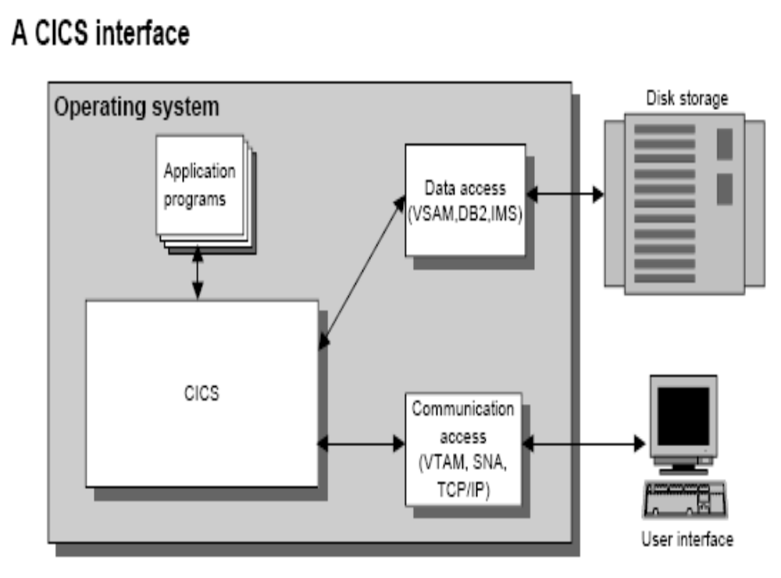
Notes:
The Customer Information Control System, or CICS, is designed to control information in a modern online environment by providing database and data communication functions.
• CICS provides an interface between application programs and operating system services, such as data access and communication access.

Slide 14
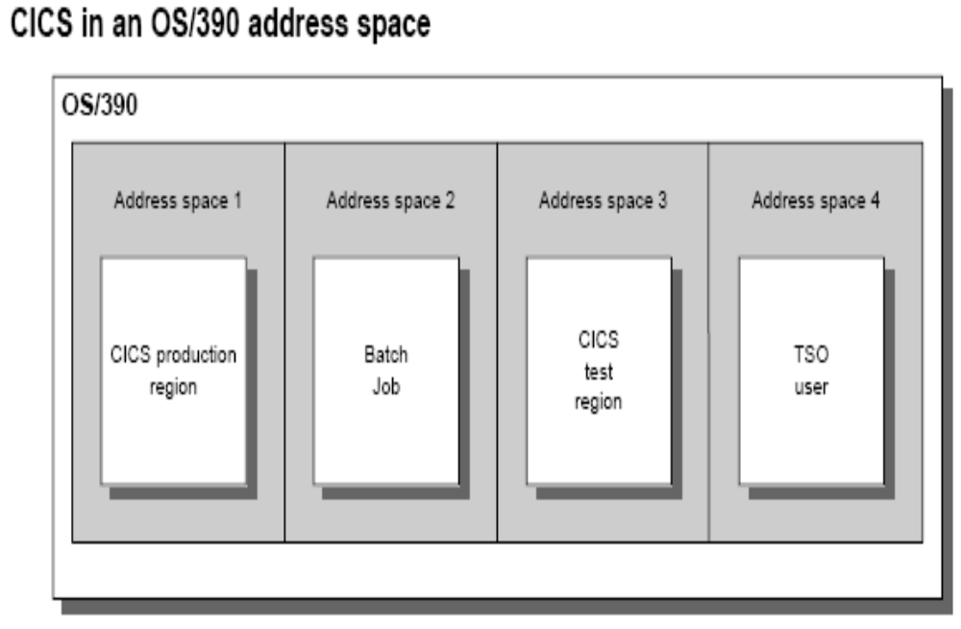
Notes:
Description
On a mainframe, CICS runs under an operating system like OS/390 or VSE/ESA.
• Although CICS runs as a batch job, it can handle hundreds of interactive users that are using a variety of applications.
• More than one CICS system (or region) can run on the same computer at the same time. Because each region runs in its own address space, programs running in one region won’t interfere with programs running in another region.

Slide 15
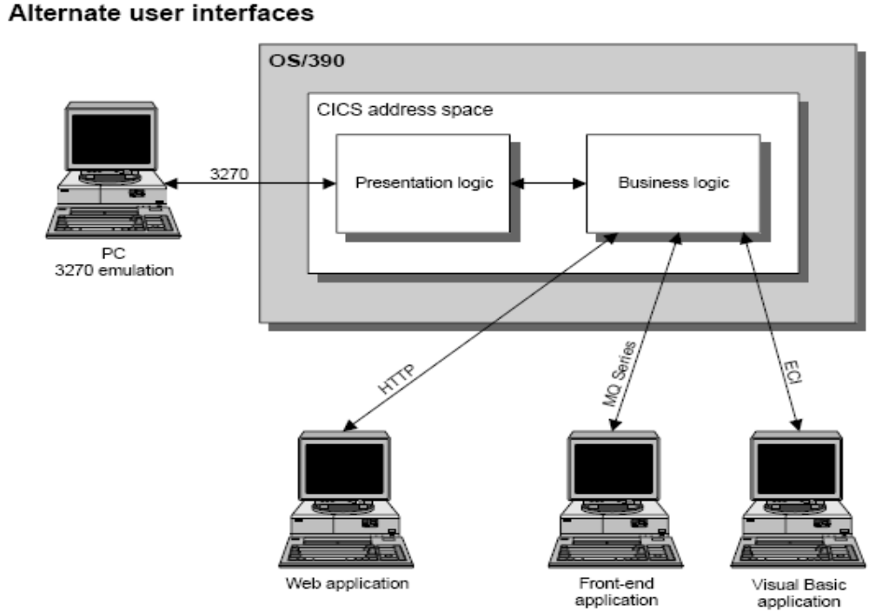
Notes:
Description
• When you use 3270 terminals or PCs running 3270 emulation software, the CICS application provides the presentation logic for the terminals or PCs. That means that CICS determines what screens will be displayed and how they will work. In this case, CICS also provides the business logic that determines how the user requests will be processed.
• CICS can also be used with other types of user interfaces. In this case, the front-end program provides the presentation logic, but the CICS application is still the back-end program that provides the business logic.
• Visual Basic is one product that can be used to develop a front-end program with a graphical user interface (GUI) that accesses a back-end program written in CICS. To access CICS programs, the Visual Basic program issues ECI calls.
• A front-end program written for another platform can retrieve data managed by CICS by issuing message requests through an IBM product called MQSeries. This message queuing product lets you send data between two disparate computer platforms.
• Web applications run in a Web browser and can access CICS programs and services through an Internet protocol like HTTP.

Slide 16
CICS SYSTEM COMPONENTS
Data-Communication Functions
Data Handling Functions
Application Program Services
System Services
Monitoring Functions
Notes:
As we have seen that, CICS positions itself between the operating system and application programs. The essential role of CICS is, therefore to interface between application programs and the operating system as the DB/DC control system. To this end, CICS consists of five major system components, each of which provides the various specialized CICS services as follows:
Data communication functions
Data handling functions
Application program services
System services
Monitoring functions

Slide 17
CICS SYSTEM CONCEPT
Other
Systems
Other
Systems
Operating System (MVS/XA)
Other
Systems
Database Access method (DL/I,DB2)
Data Access Method (VSAM, BDAM)
Telecommunication Access Method (VTAM,TCAM, BTAM)
_{Terminals}
_{Terminals}
_{Terminals}
CICS/MVS
System Services
Data-Handling Functions
Monitoring Functions
Data-Comm. Functions
Application Program Services
CICS Application Programs (COBOL,PL/I, Assembler)
Notes:
This CICS system concept can best be interpreted with this diagram. Let us see each of these components in detail.
1.System Services : Provides Program Control,
Provides Storage Control.
Provides Task Control.
2. Data Communication Services :
Interfaces with telecommunication access methods,
Provides Multi Region Operation (MRO),
Provides Inter System Communication (ISC),
3. Data Handling Services :
Provides interface with data access methods,
Provides interface with database access methods
4. Application Programming Services :
Interfaces with application programs.
Provides CICS command level translation.
5. Monitoring Services :
Monitors various events within CICS

Slide 18
SYSTEM SERVICES
Program Control
Storage Control
Task Control
Notes:
This component provides an interface between CICS and operating system. The services includes:
*)program control such as load and release of application programs;
*)storage control such as acquiring and freeing of storage;
*)task control such as task scheduling based on task priority.

Slide 19
DATA COMMUNICATION FUNCTIONS
Interface to telecommunication access methods
Free application programs from terminal hardware
Provide MRO
Provide Inter System Communication
Notes:
The component of data communication functions provides an interface between CICS and terminals or other systems.
It provides various services as listed here.
*) It acts as an interface to the telecommunication access methods such as VTAM, BTAM or TCAM.
*)it frees the application programs from the terminal hardware through the Basic Mapping Support (BMS);
*)it provides Multi-Region Operation (MRO) through which more than one CICS region in a system can communicate.
*)It provides Inter System Communication (ISC) through which a CICS region of a system can communicate with other CICS regions in other systems or other non-CICS systems.

Slide 20
DATA HANDLING FUNCTIONS
Interface with data access methods
Interface with database access methods
Maintain data integrity
Notes:
The component of data handling functions provides an interface between CICS and data. The services are :
*) to interface with data access methods such as VSAM and BDAM;
*)to interface with database access methods such as DB2, SQL/DS and DL/I.
*)To maintain integrity by protecting the data at task abends and System failures and control of simultaneous record updates

Slide 21
APPLICATION PROGRAM SERVICES
Interface with COBOL, PL/I, Assembler Programs
Command level translator
Execution Diagnostic facility
Command Interpreter
Screen Definition Facility
Trace and Dump Facility
Notes:
The various application program services provides an interface between CICS and application programs. its services are :
*)to provide an interface with languages like COBOL, PL/I, Assembler programs in which the applications are developed.
*)It acts as a command level translator.
*)It provides Execution diagnostic facility through which the application program can be traced for its errors (or bugs) if any.
*)It provides screen definition facility for better interaction with the user and the system.
*)Trace and Dump facility to trap the various errors and rectify them accordingly for proper execution of the application program.

Slide 22
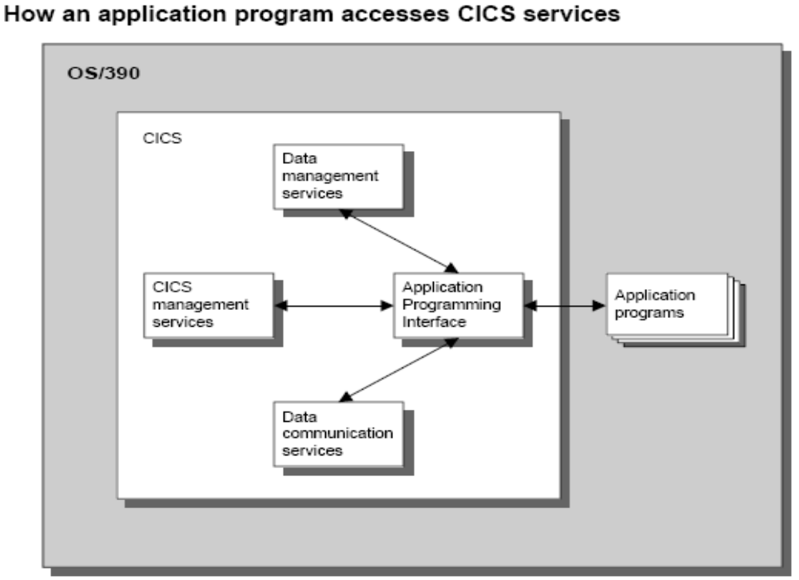
Notes:
Description
• CICS provides many services that are available to an application program through its Application Programming Interface, or API. This API insures that all the services are invoked in a consistent manner.
• The data communication services allow users to communicate with programs through their terminals.
• The data management services let programs access data stored in files or databases.
• The CICS management services provide a variety of services for managing the execution of application programs.

Slide 23
Monitoring Functions
Monitor events within CICS
Provides Statistics for system tuning
Notes:
The component of monitoring functions monitors the various events within CICS and provides a series of statistics to be used for system tuning.

Slide 24
Concepts of CICS
Multitasking
Multithreading
Quasi-Reentrancy
Notes:
The chief concepts of CICS are multitasking, multithreading and quasi reentrancy. Let us see each of these in detail.

Slide 25
MULTITASKING
Concurrent execution of more than one task
Notes:
Multitasking means that a program running in a single partition or region allows multiple tasks to execute simultaneously. A task is an execution of a program or programs for a specific user Eg. if user 1 is running PGM A then user1 has created a task.
Multitasking means that the operating system allows more than one task to be executed concurrently, regardless of whether the task use the same program or different programs. CICS manages multitasking of CICS tasks in its own region. CICS controls many tasks running concurrently in a single partition using task switching mechanism.

Slide 26
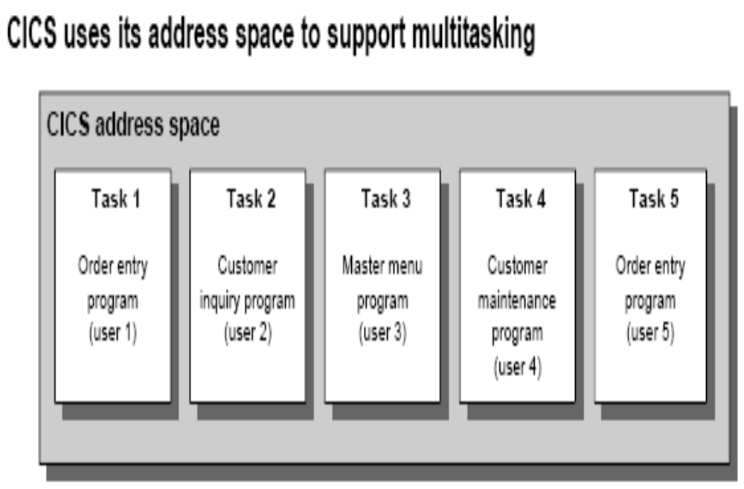
Notes:
Description
• A task is the execution of an application program for a specific user. Within CICS, two
or more tasks can execute at the same time using a CICS feature called multitasking.
• Although all of the operating systems that support CICS provide multitasking of their
own, CICS handles multitasking internally. This provides for a stable system that works
the same way under any operating system.

Slide 27
MULTI THREADING
A Program is shared by several tasks concurrently
Notes:
Multithreading is the system environment where the tasks are sharing the same program under the multitasking environment.
Multithreading is a subset of multitasking, since it concerns tasks which use the same program. Under the multithreading environment, a program is shared by several tasks concurrently. For each task, the program must work as if it were executing instructions exclusively for each task. Therefore, it requires special considerations such as reentrancy.
Multithreading is a technique that allows a single copy of an application program to be processed by several transactions concurrently. For example, one transaction may begin to execute an application program. When an EXEC CICS(R) command is reached, causing a CICS WAIT and call to the dispatcher, another transaction may then execute the same copy of the application program. (Compare this with single-threading, which is the execution of a program to completion: processing of the program by one transaction is completed before another transaction can use it.)
Multithreading requires that all CICS application programs be quasi- reentrant; that is, they must be serially reusable between entry and exit points. CICS application programs using the EXEC CICS interface obey this rule automatically.

Slide 28
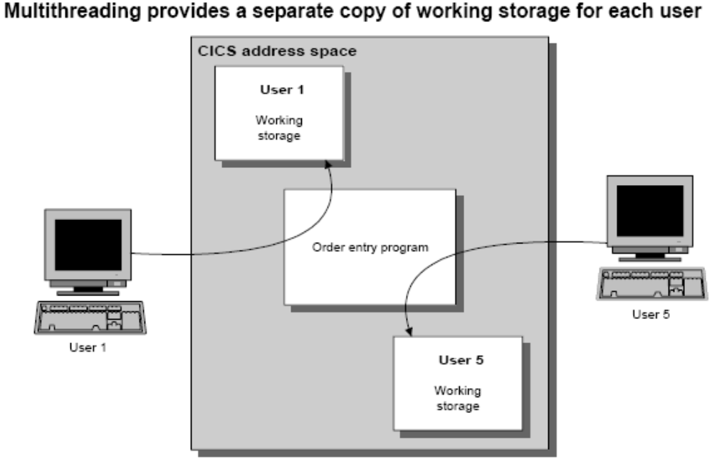
Notes:
Description
• CICS also provides a feature called multithreading. With multithreading, two or more users can access the same copy of a program at the same time. CICS accomplishes this by providing a separate copy of working storage for each user running the program.

Slide 29
QUASI-REENTRANCY
Re-entrant program under CICS environment
Notes:
The quasi-reentrant program is a CICS program which does not modify itself. That way, it can reenter to itself and continue processing after an interruption by CICS which, during the interruption, executes other CICS tasks including CICS tasks of the same program. In order to make multi threading possible an application program must be quasi-reentrant i.e., the program should be serially reusable.
CICS runs user programs under a CICS-managed task control block (TCB). If your programs are defined as quasi-reentrant (on the CONCURRENCY attribute of the program resource definition), CICS always invokes them under the CICS quasi-reentrant (QR) TCB. The requirements for a quasi-reentrant program in a multithreading context are less stringent than if the program were to execute concurrently on multiple TCBs.
CICS requires that an application program is reentrant so that it guarantees consistent conditions. In practice, an application program may not be truly reentrant; CICS expects "quasi-reentrancy". This means that the application program should be in a consistent state when control is passed to it, both on entry, and before and after each EXEC CICS command. Such quasi-reentrancy guarantees that each invocation of an application program is unaffected by previous runs, or by concurrent multi-threading through the program by multiple CICS tasks.
For example, application programs could modify their executable code, or the variables defined within the program storage, but these changes must be undone, or the code and variables reinitialized, before there is any possibility of the task losing control and another task executing the same program.
CICS quasi-reentrant user programs (application programs, user-replaceable modules, global user exits, and task-related user exits) are given control by the CICS dispatcher under the QR TCB. When running under this TCB, a program can be sure that no other quasi-reentrant program can run until it relinquishes control during a CICS request, at which point the user task is suspended, leaving the program still "in use".The same program can then be reinvoked for another task, which means the application program can be in use concurrently by more than one task, although only one task at a time can actually be executing.
To ensure that programs cannot interfere with each others working storage, CICS obtains a separate copy of working storage for each execution of an application program. Thus, if a user application program is in use by 11 user tasks, there are 11 copies of working storage in the appropriate dynamic storage area (DSA).
Quasi-reentrancy allows programs to access globally shared resources--for example, the CICS common work area (CWA)--without the need to protect those resources from concurrent access by other programs. Such resources are effectively locked exclusively to the running program, until it issues its next CICS request. Thus, for example, an application can update a field in the CWA without using compare and swap (CS) instructions or locking (enqueuing on) the resource.

Slide 30
Terminologies in CICS
Application
Transaction
Task
Notes:
We need to understand certain terminologies commonly used in CICS to work comfortably with this environment.
They are application, transaction, task.

Slide 31
What is an Application?
Collection of Programs
Notes:
An application is a collection of programs which accomplish some specific user work. For example,
in a bank, we could think about having an application which allow banker to:
· maintain customer details
· view the customer list etc.

Slide 32
What is a Transaction?
Collection of logically related programs
Notes:
What is a transaction?
A CICS transaction is a collection of logically related programs in an application, i.e., the whole
application could be logically divided into several transactions. Users tell CICS what type of
transaction they want to do next by using a transaction identifier which is 1 to 4 characters long.
The programmer associates one of the programs to a transaction identifier and this program in turn
invokes all other programs which belong to that transaction. Finally, a single transaction , when run,
will carry out the processing needed.

Slide 33
What is a Task?
Single execution of some type of transaction
Notes:
What is a task?
Users invoke an application by using one of the transaction identifiers. CICS looks up the
transaction identifier to find out which program to invoke first to do the work requested. It creates a
task to do the work, and transfers control to the indicated program. So a task is a single
execution of some type of transaction. That means, a transaction could be completed through
several tasks (we will discuss this in detail when we deal with pseudo-conversational programming).
Like transactions, tasks also can span across several programs.

Slide 34
CICS NUCLEUS
Control Tables
Control Programs
Notes:
CICS system programs, each of which performs its specialized function is called the CICS nucleus. It consists of IBM supplied CICS control programs and corresponding user defined CICS control tables.

Slide 35
CICS CONTROL PROGRAMS AND TABLES
TERMINAL MANAGEMENT
PROGRAM MANAGEMENT
STORAGE MANAGEMENT
TASK MANAGEMENT
FILE MANAGEMENT
Notes:
CICS environment consists of five management service modules. They are: terminal management, program management, storage management, task and file management. Let us see the control programs and tables associated with each of these modules in some of the following slides.

Slide 36
Terminal Management
Terminal control program (TCP)
Terminal control table (TCT)
Terminal I/O area (TIOA)
Notes:
Terminal management comprises of TCP,TCT and TIOA.
Terminal Control Program (TCP) polls terminals, and handles different protocols.
TCT describes each terminal in the network by type, priority and address.
TIOA holds message from the terminal until working storage for the application program is defined; holds messages being sent to a terminal, until the line is free for transmission.

Slide 37
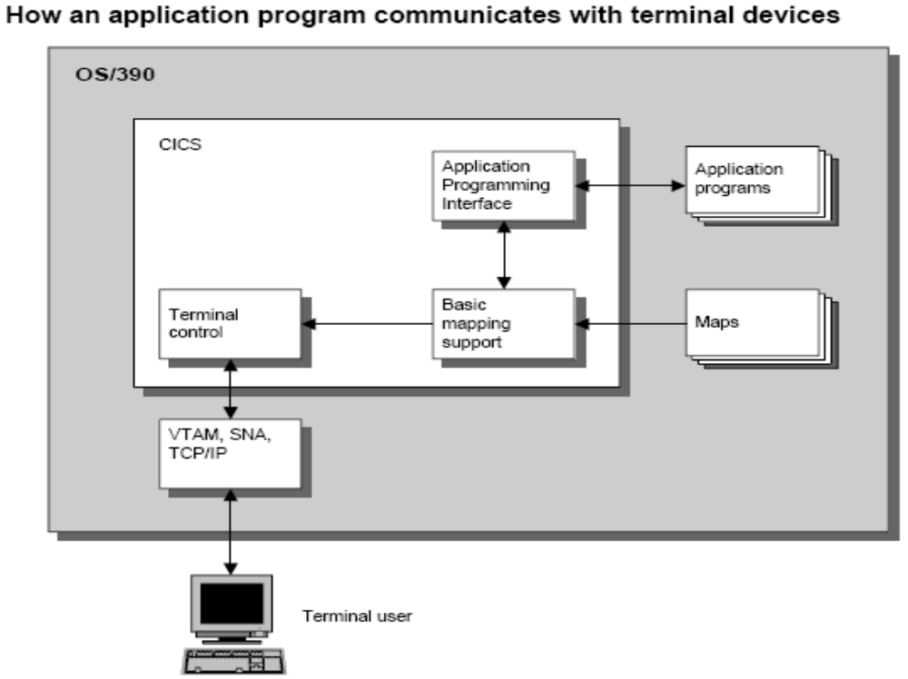
Notes:
Description
• Terminal control provides the interface between CICS and the operating system’s telecommunication access method. It lets you send text or receive text from the terminal that initiated the task.
• The most common telecommunication access methods are VTAM (the Virtual Telecommunication Access Method), SNA (Systems Network Architecture), and TCP/IP (Transmission Control Protocol/Internet Protocol). Some of these access methods can also be used in combination with each other.
• Basic mapping support (BMS) provides the interface between application programs and terminal control. It lets you create maps that specify the position and the characteristics of the individual display elements on the terminal screen. As a result, you can create interfaces that are easy for users to work with.
• Each terminal in the CICS system must be defined in the Terminal Control Table (TCT). Each terminal in this table is assigned a unique one- to four-character terminal identifier, or term-id.

Slide 38
PROGRAM MANAGEMENT
Program Control program (PCT)
Processing Program Table (PPT)
Notes:
PCP keeps track of which programs are in storage and where they are located.
PPT defines system elements such as program name, language, primary storage address and disk address

Slide 39
STORAGE MANAGEMENT
Storage Control program (SCP)
Notes:
Storage management has only the storage Control Program which acquires and releases storage as necessary.

Slide 40
TASK MANAGEMENT
Task Control Program (KCP)
Program Control Table (PCT)
Task Control Area (TCA)
Execute Interface Block (EIB)
Notes:
KCP tracks which terminal is using which program and controls task priority.
PCT contains information related to the transaction-id and its associated program;
TCA contains pointers to storage areas and control areas for programs and terminals.
the EIB is used in CICS command level environment. each task has an EIB associated with it. EIB contains system related information such as Transaction ID, Date, Time, Cursor position etc which can be accessed by application program.

Slide 41
FILE MANAGEMENT
File Control Program (FCP)
File Control table (FCT)
File I/O Area (FIOA)
Notes:
FCP interacts with system access methods to perform file I/O requests.
FCT contains information on files related to file name, buffer requirements, allowable services such as read, write, update etc., and file characteristics.
FIOA holds the control interval that contains the requested logical record.

Slide 42
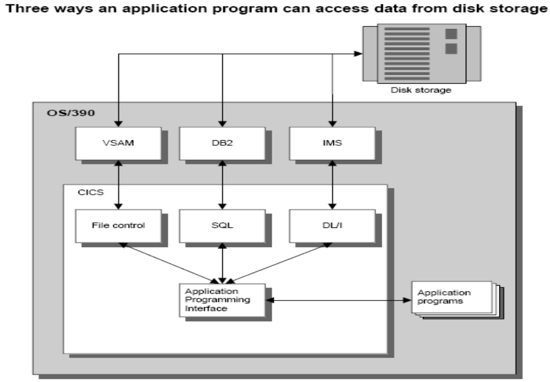
Notes:
Description
• CICS provides three services to manage data: file control, SQL, and DL/I.
• File control passes data requests made by a program to VSAM. VSAM, in turn, manages the data stored in files on direct access devices.
• Each file accessed by CICS must be defined in the File Control Table, or FCT. The FCT specifies the file name, along with other information such as the file type and the operations that can be performed on the file.
• SQL passes data requests made by a program to IBM’s relational database system, DB2.
• DL/I passes data requests made by a program to IBM’s hierarchical database system, IMS.

Slide 43
Enter Transid
MP41
PCT
PPT
Transaction Programs
MP20 MAPLE20P
MP41 MAPLE41P
D325 CDAL325P
Program Location
MAPLE20P In Storage
MAPLE41P On Disk
CDAL325P In Storage
CICS Address space
MAPLE41P
Library Load Module
MAPLE20P MAPLE20P
MAPLE41P MAPLE41P
CDAL325P CDAL325P
CDAL325P
Notes:
Let Us now see how CICS invokes an application program ……
When transaction identifier mp41 is entered on the CICS terminal, first it checks if there is a program associated with this Transaction identifier in the PCT table. If it finds, then it checks in the PPT table to find the location of Program to execute it. If the program is already available in the memory it starts executing that particular program, if not, it loads the program to the memory from secondary storage and then starts executing it.

Slide 44
Native CICS Commands
CESN: CICS Execute Sign ON
CEDA: CICS Execute Definition and Administration
CEMT: CICS Execute Master Terminal
CECI: CICS Execute Command Interpreter
CEDF: CICS Execute Debug Facility
CMAC: CICS Messages for Abend Codes
CESF: CICS Execute Sign OFF
CEBR – CICS Execute temporary storage BRowse
Notes:
We have certain native CICS commands that can be used in the CICS region.
CESN : Is used to Sign on to CICS region.
CEDA : Is used by CICS System Administrators to define CICS table entries and other administration activities.
CEMT - This command is normally used to inquire and update the status of CICS environments and also for other system operations. One can manipulate transactions, tasks, files, programs and TSQs using this. Again, very similar to CECI, all one needs to do is to type CEMT and press enter and all the possible options are displayed. Command to close a file can be given like this
E.g.: CEMT SET FILE (filename)
One can overwrite the status of the file displayed to change it.
CECI – Most of the CICS commands can be executed using CECI. It is also used to check the syntax of the command and if the syntax is rightly entered, it even executes the command. Many operations can be performed using this command. All one needs to do is to type the CECI option on the empty CICS screen after having logged in. It gives you the list of options available.
E.g.: CECI SEND MAP (mapname) MAPSET (mapsetname) ERASE
CEDF – This provides interactive debugging of the program wherein we can stepwise execution and thus easily track errors or problems. Type CEDF and press enter in CICS region. One will get a message that the terminal is in EDF mode. Now type the transaction id and press the enter key. After initiation, with each enter key, a line is executed. Before executing any CICS command, it shows you the screen if you should choose to modify the values before proceeding further.
CMAC – Is used to find the explanation and reasons for CICS Abend Codes.
CESF – Is used to Sign from CICS region.
CEBR – This is used to display the contents of a temporary storage queue or TSQ. This is normally done while debugging to check if the items of the queue are being written and retrieved properly. All one needs to do to invoke this is
E.g.: CEBR queueid

Slide 45
COMMANDS IN CICS
The general format of command is:
EXEC CICS command function
option (argument)
option (argument)
END-EXEC.
Notes:
CICS is a command level language. These commands can be used in the application program. The general format of any CICS command is shown in the screen. All commands are given in EXEC CICS …. END-EXEC keywords in the application program.
Command - describes the service requested READ, WRITE, RECEIVE, SEND etc.
Option - specifies many optional functions. Some options are keywords only or followed by arguments in parentheses; eg., FROM, INTO LENGTH etc.
Argument - specifies the characteristics of the value associated. It could be a work area, a length value, a file name or a paragraph name.

Slide 46
RECEIVE COMMAND
Syntax :
EXEC CICS RECEIVE
INTO (dataname)
LENGTH (length of dataname)
END-EXEC.
Example:
EXEC CICS RECEIVE
INTO (ws-input)
LENGTH (length of ws-input)
END-EXEC.
Notes:
The RECEIVE command in CICS is meant for receiving the input from the user. The dataname is declared in the Working-storage section INTO which the data is received for processing in the procedure division of the application program. The length option used n this command is optional. The value of length may also be stored in a binary half word variable or can be a constant as well.

Slide 47
SEND COMMAND
EXEC CICS SEND
FROM (dataname)
LENGTH (length of dataname)
END-EXEC.
Example:
EXEC CICS SEND
FROM (ws-output)
LENGTH (length of ws-output)
END-EXEC.
Notes:
The SEND command is meant for sending the processed results and information to the terminal. The information is sent FROM the dataname to the terminal. In the example given the information in the ws-output variable is sent to the terminal. The length option used n this command is optional. The value of length may also be stored in a binary half word variable or can be a constant as well.

Slide 48
SEND PAGE COMMAND
EXEC CICS SEND TEXT
FROM (dataname)
ACCUM
END-EXEC.
:
:
EXEC CICS SEND
PAGE
END-EXEC.
Notes:
Text messages can be accumulated from the datanames and can be spooled so that more than one message may be sent as a PAGE to the terminal. The ACCUM option used in the send text command is meant for accumulating the text messages.

Slide 49
Execution of a CICS application program
Basic Procedure
CICS Program considerations
CICS Program Restrictions
Notes:
Basic Procedure: In order to execute an application program under CICS the following procedure should be followed:
*)Translate, compile and link edit the CICS application program into the CICS application program library (loadlib)
*)Define the transaction identifier into PCT with the associated program name
*)Define the program into PPT
*)Sign on to CICS
*)Enter the Transaction identifier
CICS Program considerations
*) Must eventually return control to CICS
*)Can’t modify procedure division instructions because CICS programs may be shared by many tasks
*)can modify working storage since a unique copy of working storage is created for each task
CICS Program Restrictions
*) no CONFIGURATION SECTION, I/O SECTION to be specified in the ENVIROMENT DIVISION.
*)FILE SECTION, OPEN, CLOSE and non-CICS READ & WRITE statements are not permitted because file management is handled by CICS
*)COBOL commands such as ACCEPT, DISPLAY, EXHIBIT,TRACE, STOP RUN, GOBACK are avoided. ( STOP RUN & GOBACK are sometimes included in order to eliminate compiler diagnostic but never executed)

Slide 50
Summary
What is CICS?
Why CICS in MVS?
How is CICS similar to OS?
What are AID, PF, PA keys?
What are transactions and tasks?
What is Multitasking, Multithreading, Quasi-reentrancy?
What are the ways of starting a transaction?
What are the CICS tables?
What is conversational and pseudo-conversational programming?
What are the native CICS Commands

Slide 51
Lab Session

Slide 52
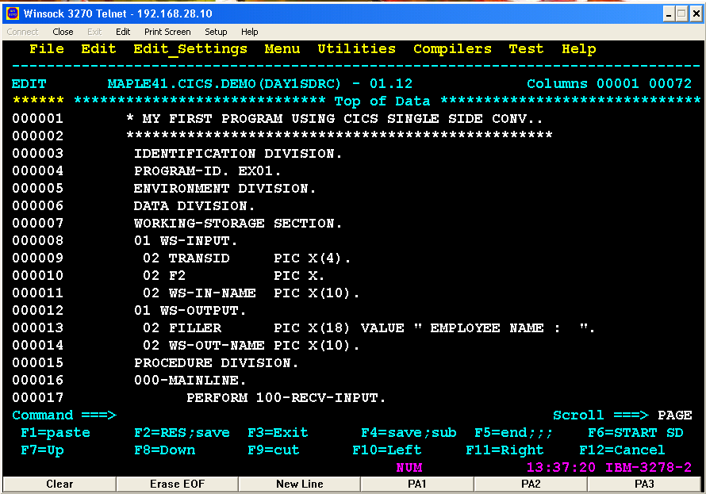
Notes:
Now we will see our first COBOL program with CICS command to RECEIVE the input from the user and send the output message. In this program, the name of the employee with the trans-id is received into ws-input in the 100-RECV-INPUT para and the output is sent to the terminal through ws-output in the 200-send-output para. The program then returns to the CICS region.

Slide 53
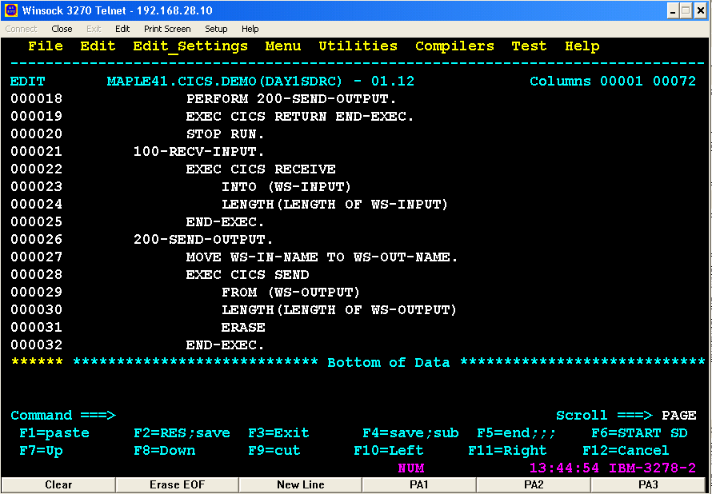
Notes:
The RECEIVE command receives the input data from the user in the 100-RECV-INPUT into the ws-input group variable( i.e trans-id with employee name) and sends the output ws-output to the user using the SEND command in the 200-SEND-OUTPUT para.

Slide 54
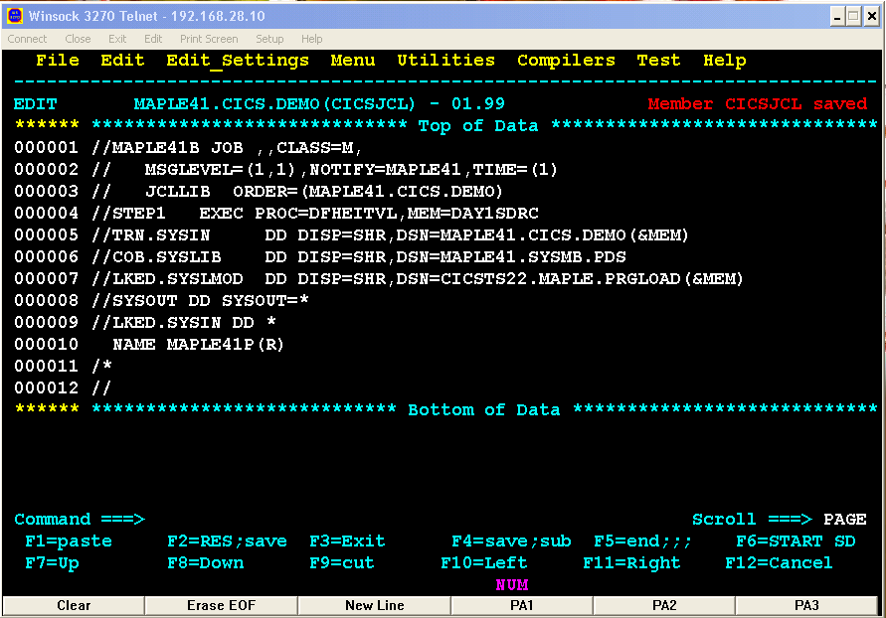
Notes:
After writing the COBOL program with CICS commands, it should be compiled with the JCL using DFHEITVL procedure. The input program is given to TRN.SYSIN. The load module is stored in the system defined pds through the LKED.SYSLMOD dd statement. LKED.SYSIN dd statement renames the program to the program-id maple41p which is system defined. The (R) is meant for re-entrant concept.
So, as the program is compiled the input program DAY1SNRC in MAPLE41.CICS.DEMO pds is translated and then compiled. The load module is available in the CICSTS22.MAPLE.PRGLOAD pds with the name of the program-id ie MAPLE41P.

Slide 55
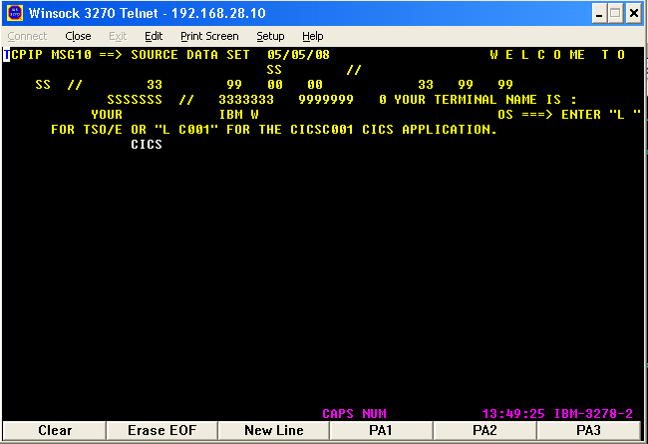
Notes:
The compiled program should be executed in the CICS region. To login to the CICS region, CICS should be typed as shown in the screen.

Slide 56
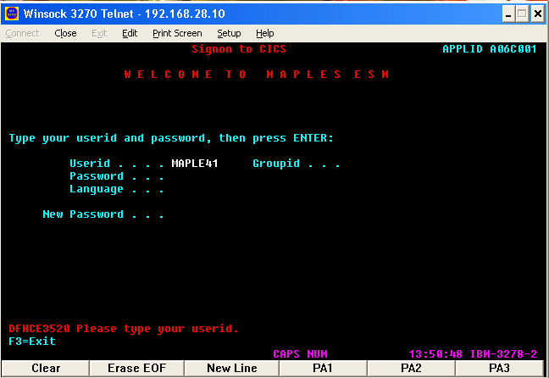
Type Userid
Notes:
The compiled program should be executed in the CICS region. The userid and password should be entered in the screen so as to SIGN ON to the CICS region.

Slide 57
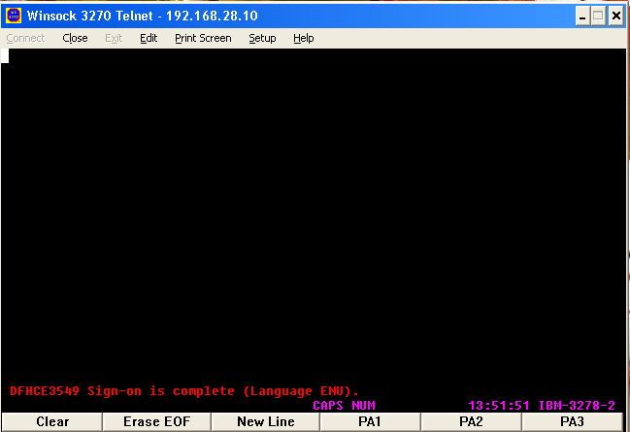
Notes:
Now, your sign-on is complete, so that your programs can be loaded and executed.
Note : Whenever any command is typed in the cics region the screen should be cleared using Alt + C (in Unix environment)
And ctrl + c(in windows environment)

Slide 58
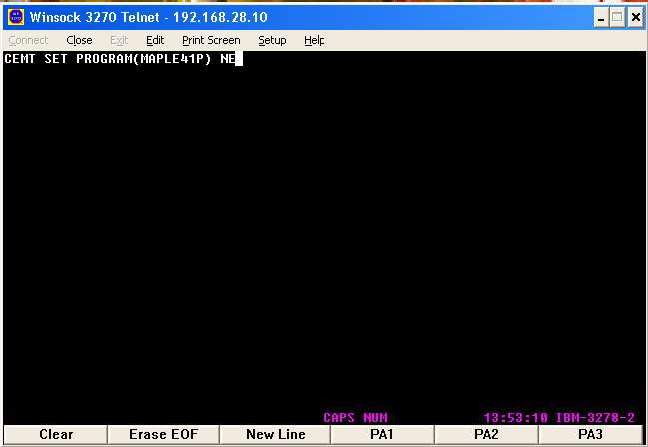
Type Program id
Notes:
To load the program referred by the program-id MAPLE41P ,type the CEMT(CICS Execute Master Terminal) command can be used. NE stands for NEW Copy to implement the Quasi reentrant concept.

Slide 59
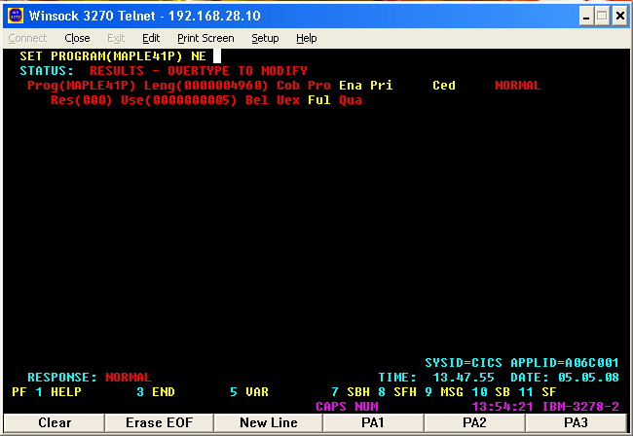
Notes:
Now if the program-id is available and is loaded successfully, then you may get the NORMAL status. The possible error you may get is NOT FOUND when the program-id is not available.

Slide 60
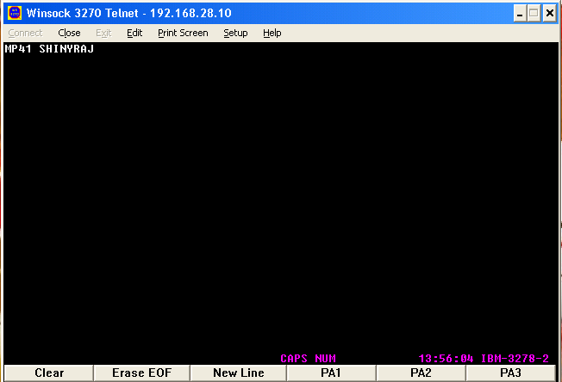
Notes:
The input to the program referred by the program-id is now executed by giving the trans-id followed by the input. The first four character corresponds to the trans-id for the program-id MAPLE41P.The input given is received into the program.
Error : the possible abend you may get is AEIV i.e LENGERR (length error). The variable that receives input is a group variable of length 15. so if the input given by the user goes beyond this you may get this abend. Hence care should be taken to give input according to the length of the variable as declared in the program.

Slide 61
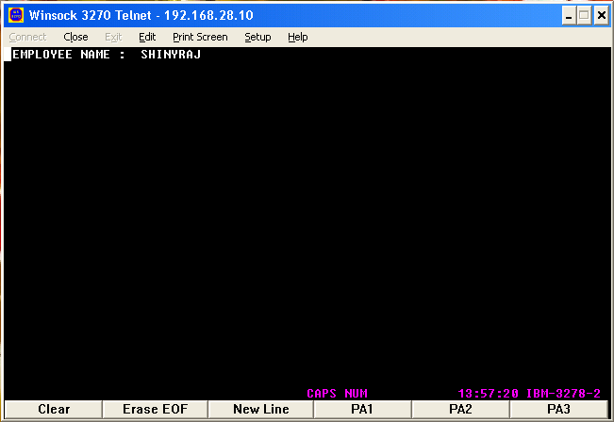
Notes:
The output is sent to the CICS region from the application program as shown here.

Slide 62
Try Yourself !
Write a program in CICS to receive two numbers from the user and find the sum and send the result to the user with suitable message.

